Slide 1
Software testing
GV: Phan Gia Phước
Nguyễn Lê Trọng Tiền
Lê Bá Quang
Huỳnh Nhựt Duy
Huỳnh Dương Mỹ Uyên

Slide 2
01
TEST LEVEL

Slide 3
Test Level
02
01
02
Unit Testing
Integration Testing
03
04
System Testing
Acceptance Testing
By Developer
By Developer and Tester
By Tester
By End User / Customer

Slide 4
Unit Testing
01
Is a software testing level to verify that each unit of software is developed as designed

Slide 5
Purpose
The source code is more reliable
The code is easy to use, understandable and reusable
Time-saving and defect correction costs lower
Easier to fix errors

Slide 6
02
Integration Testing
Integration testing tests interfaces between components, interactions with different parts of a system.

Slide 7
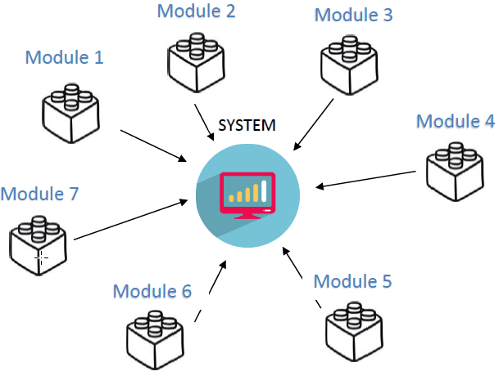
Approach
Big Bang Integration Testing is an integration testing strategy wherein all units are linked at once, resulting in a complete system.

Slide 8
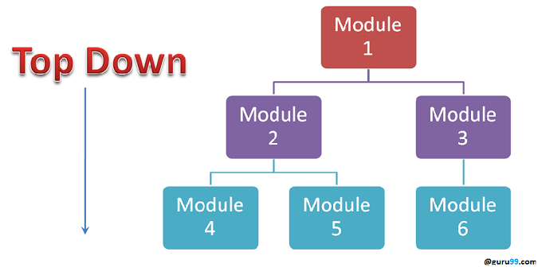
Approach
Testing is performed from top to bottom. The highest unit is tested first, the lower one is tested sequentially.

Slide 9
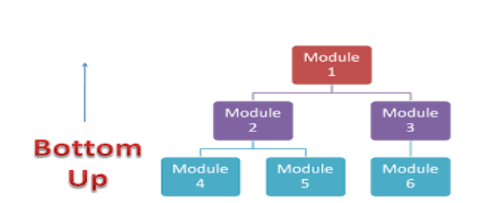
Approach
Testing is performed from bottom to top. The lowest unit is tested first, the higher unit is tested after that

Slide 10
System Testing
03
System testing is performing a test of a fully integrated system to ensure it works properly as required.

Slide 11
Purpose
Evaluate whether the system is functioning properly according to the specification document or not

Slide 12
Acceptance Testing
04
Check if the software has satisfied all the requirements of the customer? And does the customer accept the product?

Slide 13
Some Acceptance Testing Types
Alpha testing
Is performed at developer’s site, usually internal employees of the organization and ensure the quality of the product before forwarding to beta testing.
Beta testing
Is performed at end-user of the product by clients who are not part of the organization.

Slide 14
02
TEST TYPES

Slide 15
TEST TYPES
02
01
02
Functional Testing
Non-functional Testing
03
04
Structural Testing
Testing related to changes

Slide 16
Functional Testing
01
Testing based-on an analysis of the
specification of the functionality of a component or system

Slide 17
Functionality testing can be done on:
Requirements-based testing
Business-process-based testing

Slide 18
Additional functional testing
Suitability
Interoperability
Security
Accuracy
Compliance

Slide 19
02
Non-functional Testing
Is test how well or how fast something is done.

Slide 20
Non-functional Testing Included:
Performance Testing
Load Testing
Stress Testing
Usability Testing
Maintainability Testing
Reliability Testing
Portability Testing

Slide 21
03
Structural Testing
Testing based on an analysis of the internal structure of the component or system.

Slide 22
04
Testing related to changes
Is provided to ensure that previously eradicated bugs have been fixed and to catch bugs that may have been accidentally appeared in a new version.

Slide 23
Confirmation Testing:
Retesting to verify the success of corrective action
Regression Testing:
Checking the system has not regressed
To verify that modifications in the software or the
environment have not caused unintended adverse side
effects and that the system still meets its requirement.

Slide 24
THANKS!
Do you have any questions?
gachateam231@gmail.com
gachateam.com
Please, keep this slide for the attribution

Slide 25


